Slide 1
5G Project -2
By
Thammineni Satish

Slide 2
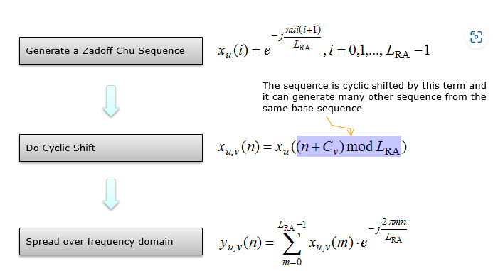
Preamble Sequence Generation
NR Preamble sequence is also based on Zadoff Chu based sequence. Overall sequence generation is as follows.
The resason why we use Zadoff Chu is same as in LTE. It is due to various favorable properties, including constant amplitude before and after DFT operation, zero cyclic auto-correlation and low crosscorrelation
There are two types of sequence in terms of sequence length(L_RA = 139 and 839).

Slide 3


Sequence generation
The set of random-access preambles shall be generated according to
From which the frequency-domain representation shall be generated according to
where LRA = 839, LRA = 139 , LRA = 1151, or LRA = 571 depending on the PRACH preamble format
There are 64 preambles defined in each time-frequency PRACH occasion, enumerated in increasing order of first increasing cyclic shift Cv of a logical root sequence, and then in increasing order of the logical root sequence index, starting with the index obtained from the higher-layer parameter prach-RootSequenceIndex or rootSequenceIndex-BFR or by msgA-PRACH-RootSequenceIndex if configured and a type-2 random-access procedure is initiated. Additional preamble sequences, in case 64 preambles cannot be generated from a single root Zadoff-Chu sequence, are obtained from the root sequences with the consecutive logical indexes until all the 64 sequences are found. The logical root sequence order is cyclic; the logical index 0 is consecutive to +RA − 2. The sequence number u is obtained from the logical root sequence index.

Slide 4
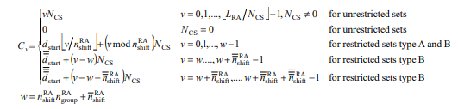
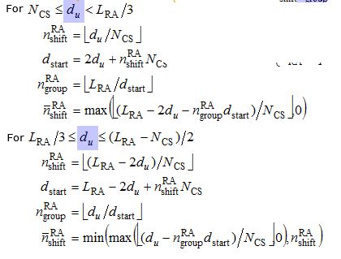

Determined by zeroCorreleationZoneConfig
Frequency Domain Sequence Generation
The Value is 139 or 839 or 1151 or 571
Frequency Domain Representation
For all other values of du, there are no cyclic shifts in the restricted set

Slide 5
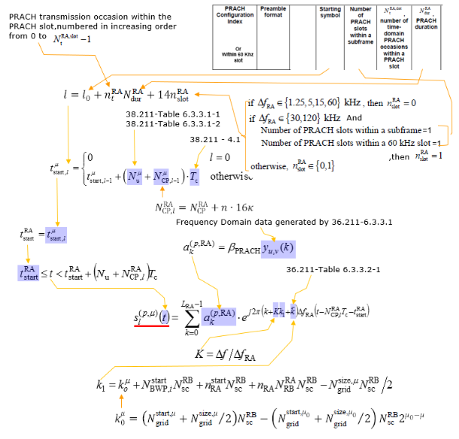
Time Domain Sequence Generation
Time Domain Representation

Slide 6
RACH Sequence Example
ENDC - CBRA(Contention Based RACH)
This is an example of ENDC CBRA captured Following is the RACH configuration for this example sequence.
rach-ConfigCommon setup: {
rach-ConfigGeneric {
prach-ConfigurationIndex 160, ==> Preamble Format B4
msg1-FDM one,
msg1-FrequencyStart 0,
zeroCorrelationZoneConfig 15,
preambleReceivedTargetPower -110,
preambleTransMax n7,
powerRampingStep dB4,
ra-ResponseWindow sl20
},
ssb-perRACH-OccasionAndCB-PreamblesPerSSB one: n8,
ra-ContentionResolutionTimer sf64,
prach-RootSequenceIndex l139: 1,
msg1-SubcarrierSpacing kHz30,
restrictedSetConfig unrestrictedSet
},

Slide 7
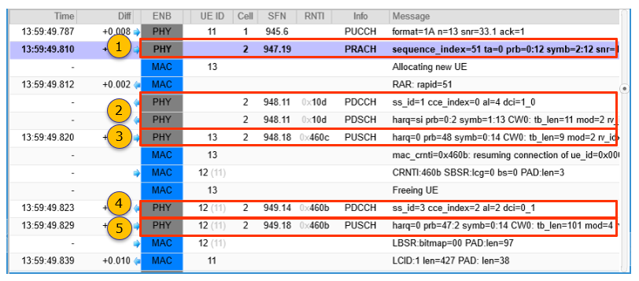
(1) msg1 - PRACH
PRACH => Message: sequence_index=51 ta=0 prb=0:12 symb=2:12 snr=15.5
(2) msg2 - RAR
MAC => Message: RAR: rapid=51
PDCCH => Message: ss_id=1 cce_index=0 al=4 dci=1_0
PDSCH => Message: harq=si prb=0:2 symb=1:13 CW0: tb_len=11 mod=2 rv_idx=0 cr=0.19
(5) msg5 - PUSCH
PUSCH =>
Message: harq=0 prb=47:2 symb=0:14 CW0: tb_len=101 mod=4 rv_idx=0 cr=0.64 retx=0 crc=OK snr=20.7 epre=-57.3
MAC => Message: LBSR:bitmap=00 PAD:len=97
(3) msg3 - PUSCH
PUSCH =>
Message: harq=0 prb=48 symb=0:14 CW0: tb_len=9 mod=2 rv_idx=0 cr=0.30 retx=0 crc=OK snr=23.3 epre=-57.4
(4) msg4 - PDCCH with UL Grant
PDCCH => Message: ss_id=3 cce_index=2 al=2 dci=0_1

Slide 8
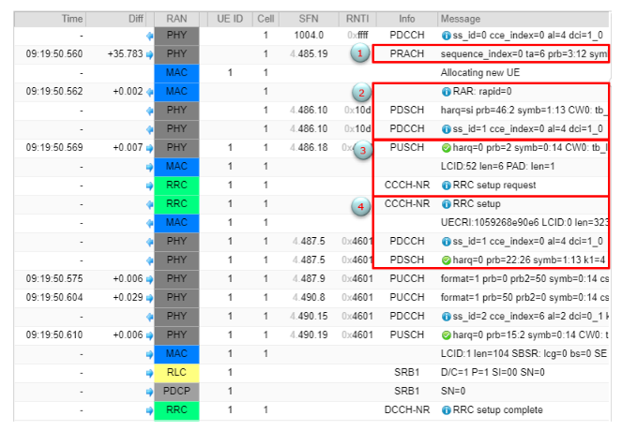
RACH Sequence Example SA - CBRA(Contention Based RACH)

Slide 9
1. PRACH @ SFN 485.19
Time: 09:19:50.560
Message: sequence_index=0 ta=6 prb=3:12 symb=2:12 snr=18.5
2. RAR
Time: 09:19:50.562
Message: RAR: rapid=0
Data:
rapid=0
ta=6
ul_grant:
hopping_flag=0
riv=0x2
time_domain_rsc=2
mcs=4
tpc_command=3
csi_request=0
tc-rnti=0x4601
PDSCH @ SFN 486.10
Time: 09:19:50.562
Message: harq=si prb=46:2 symb=1:13 CW0: tb_len=11 mod=2 rv_idx=0 cr=0.19
PDSCH @ SFN 486.10
Time: 09:19:50.562
Message: harq=si prb=46:2 symb=1:13 CW0: tb_len=11 mod=2 rv_idx=0 cr=0.19
PDCCH @ SFN 486.10
Time: 09:19:50.562
Message: ss_id=1 cce_index=0 al=4 dci=1_0
Data:
rb_alloc=0x5e
time_domain_rsc=0
vrb_to_prb_map=0
mcs=2
tb_scaling=0
PUSCH @ SFN 486.18
Time: 09:19:50.569
Message: harq=0 prb=2 symb=0:14 CW0: tb_len=9 mod=2 rv_idx=0 cr=0.30 retx=0
crc=OK snr=17.3 epre=-110.1 ta=-0.5
Time: 09:19:50.569
Message: RRC setup request
UECRI
Time: 09:19:50.569
Message: UECRI:1059268e90e6 LCID:0 len=323 PAD: len=7

Slide 10
RrcSetupRequest
Data:
0000: 10 59 26 8e 90 e6 .Y&...
{
message c1: rrcSetupRequest: {
rrcSetupRequest {
ue-Identity randomValue: '000001011001001001101000111010010000111'B,
establishmentCause mo-Signalling,
spare '0'B
}
}
}
RrcSetup
{
message c1: rrcSetup: {
rrc-TransactionIdentifier 0,
criticalExtensions rrcSetup: {
radioBearerConfig {
srb-ToAddModList {
{
srb-Identity 1
}
}
},
masterCellGroup {
cellGroupId 0,
......
}
PDCCH @ SFN 487.5
Time: 09:19:50.569
Message: ss_id=1 cce_index=0 al=4 dci=1_0
Data:
rb_alloc=0x469
time_domain_rsc=0
vrb_to_prb_map=0
mcs=6
ndi=1
rv_idx=0
harq_process=0
dai=0
tpc_command=1
pucch_rsc=0
harq_feedback_timing=3
PDSCH @ SFN 487.5
Time: 09:19:50.569
Message: harq=0 prb=22:26 symb=1:13 k1=4 CW0: tb_len=341 mod=2 rv_idx=0 cr=0.44 retx=0

Slide 11
H-ARQ
The "H" in HARQ means "Hybrid" which implies that HARQ is a combination of " FEC (forward error correction)" and "ARQ". FEC is also not LTE specific technology and a kind of generic error correction mechanism.
Basic concept of HARQ in NR is similar to LTE HARQ, but there is some minor differences in terms of the details
Asynchronous HARQ in both downlink and Uplink : In LTE HARQ, downlink use Asynchronous mechanism but Uplink uses Synchronous mechanism. In contrast, in NR both downlink and Uplink Asynchronous mechanism is used. (For the definition of Asynchronous HARQ and Synchronous HARQ, refer to LTE HARQ). Just to give you an practical aspect of Asynchronous HARQ, it operates the multiple HARQ processes in any order. To keep track of each HARQ process even when they are not running in order, the sender and receiver in the HARQ process should know the exact HARQ process number for each transmission/reception of the HARQ data. For this, DCI carries the field called HARQ Processor number. In LTE, only the DCI for downlink scheduling (i.e, DCI 1, DCI 2 etc.) carries this field (since LTE DL use Asynchronous HARQ) and the DCI for uplink schedule(i.e, DCI 0) does not carry this field(since LTE UL use Synchronous HARQ). However in NR, both Downlink Scheduling DCI (i.e, DCI 1_0, 1_1) and Uplink Scheduling DCI (i.e, DCI 0_0, 0_1) carries the field HARQ Processor Number since they both use Asynchronous HARQ.
Flexible Timing between Data Transmission and HARQ response : In LTE the timing between data transmission and HARQ response is fixed. It is fixed as 4 ms in FDD. The timing is determined in a little bit complicated way in LTE TDD. But this timing is flexibly set in NR in combination of DCI and RRC. In NR, RRC message defined a table listing multiple possible timing between data and HARQ and DCI specifies a specific elements of the table defined in the RRC message
Codebook Based HARQ Bit Construction : The number of bits and the meaning of each bits in HARQ response is quite a straightforward, but in NR the number of the HARQ bits is constructed in pretty complicated way as described in HARQ-ACK Codebook
NO ACK/NACK for PUSCH : At the very high level view, NR PUSCH HARQ mechanism is very similar to NB IoT PUSCH mechanism. There is no explicit HARQ ACK/NACK for PUSCH. Then, how UE can figure out whther the PUSCH is successfully delivered or not ? It figures it out based on whether it gets retransmission request from gNB or not. If gNB does not send retransmission request (i.e, DCI 0_0/0_1 with NDI not toggled) for a certain period of time, UE assumes that PUSCH is successfully recieved and decoded by gNB.

Slide 12
HARQ processor
Unlike LTE, in NR the max number of HARQ processor is configurable in RRC message as shown below. If this IE is not configured, it is assumed to be 8.
PDSCH-ServingCellConfig ::= SEQUENCE {
codeBlockGroupTransmission SetupRelease { PDSCH-CodeBlockGroupTransmission } OPTIONAL,
xOverhead ENUMERATED { xOh6, xOh12, xOh18 } OPTIONAL,
nrofHARQ-ProcessesForPDSCH ENUMERATED {n2, n4, n6, n10, n12, n16} OPTIONAL,
pucch-Cell ServCellIndex OPTIONAL, -- Cond SCellAddOnly
[[
maxMIMO-Layers INTEGER (1..8) OPTIONAL, -- Need M
processingType2Enabled BOOLEAN OPTIONAL -- Need M
]]
}

Slide 13
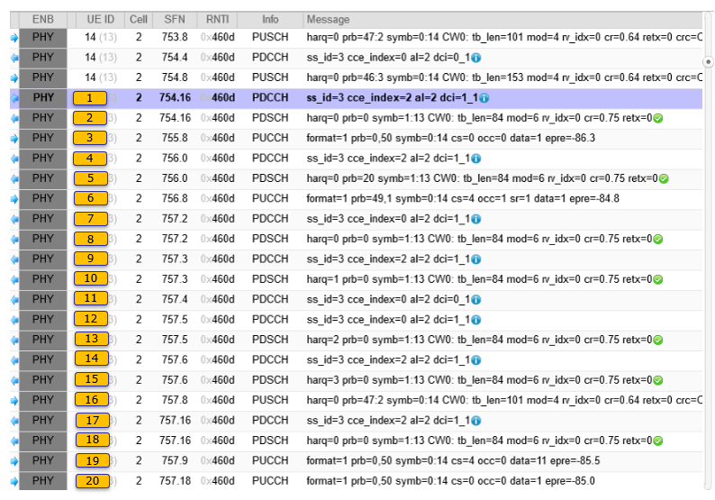
A sample trace log showing sequences of HARQ

Slide 14
RRC Parameters
In LTE, UE and gNB was able to decode PDSCH and PUSCH purely based on DCI, but in NR to receive PDSCH and PUSCH at proper timing and to get some critical parameters from RRC message that are required for PDSCH/PUSCH decoding. Followings are those parameters in RRC.
pdsch-ConfigCommon setup: {
pdsch-TimeDomainAllocationList {
{
mappingType typeA,
startSymbolAndLength 40
}
}
}
tdd-UL-DL-ConfigurationCommon {
referenceSubcarrierSpacing kHz30,
pattern1 {
dl-UL-TransmissionPeriodicity ms5,
nrofDownlinkSlots 7,
nrofDownlinkSymbols 2,
nrofUplinkSlots 2,
nrofUplinkSymbols 0
}
},
dl-DataToUL-ACK {
8,
6,
4,
12
}
pucch-Config setup: {
resourceSetToAddModList {
{
pucch-ResourceSetId 0,
resourceList {
0,
1,
2,
3,
4,
5,
6,
7
}
},
{
pucch-ResourceSetId 1,
resourceList {
8,
9,
10,
11,
12,
13,
14,
15
}
}
},
pusch-ConfigCommon setup: {
pusch-TimeDomainAllocationList {
{
k2 4,
mappingType typeA,
startSymbolAndLength 27
},
{
k2 4,
mappingType typeA,
startSymbolAndLength 27
}

Slide 15
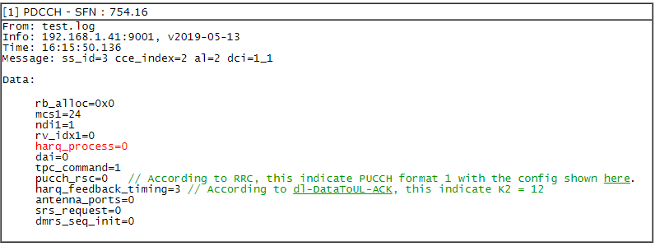
resourceToAddModList {
{
pucch-ResourceId 0,
startingPRB 0,
intraSlotFrequencyHopping enabled,
secondHopPRB 50,
format format1: {
initialCyclicShift 0,
nrofSymbols 14,
startingSymbolIndex 0,
timeDomainOCC 0
}
},
{
pucch-ResourceId 1,
startingPRB 0,
intraSlotFrequencyHopping enabled,
secondHopPRB 50,
format format1: {
initialCyclicShift 4,
nrofSymbols 14,
startingSymbolIndex 0,
timeDomainOCC 0
}
},
To analyze HARQ process, the first thing you need to do is to identify a specific HARQ number and follow through all the steps with the same HARQ process number. In this example, I marked HARQ process number with different color

Slide 16
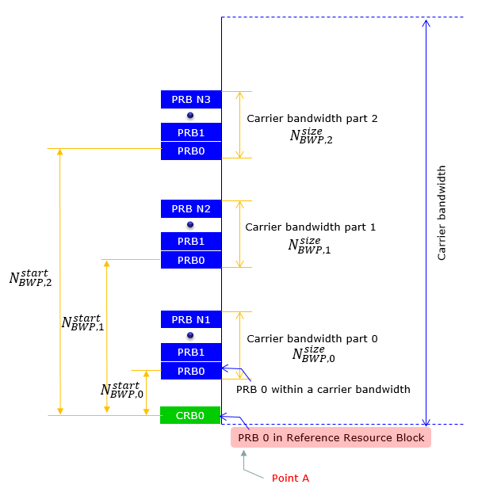
Bandwidth Part
Carrier Bandwidth Part is a contiguous set of physical resource blocks,selected from a contiguous subset of the common resource blocks for a given numerology(u) on a given carrier.
Maximum 4 BWP can be specified in DL and UL. Following illustration is only an example showing the case of 3 BWP. (NOTE : CRB in this illustration stands for Carrier Resource Block which is numbered from the one end through the other end of Carrier Band (this is a kind of global resource block), the PRB stands for Physical Resource Block is the resource blocks numbered within each BWP).
Point A indicates a common reference point for resource block grids and is obtained from the following higher-layer parameters
PRB-index-DL-common for a PCell downlink represents the frequency offset between point A and the lowest subcarrier of the lowest resource block of the SS/PBCH block used by the UE for initial cell selection;
PRB-index-UL-common for a PCell uplink in paired spectrum represents the frequency offset between point A and the frequency location based on ARFCN of the uplink indicated in SIB1;
PRB-index-UL-common for a PCell uplink in unpaired spectrum represents the frequency offset between point A and the lowest subcarrier of the lowest resrouce block of the SS/PBCH block used by the UE for initial cell selection;
PRB-index-DL-Dedicated for an SCell downlink represents the frequency offset between point A and the frequency location based on ARFCN in the higher-layer SCell configuration;
PRB-index-UL-Dedicated for an SCell uplink represents the frequency offset between point A and the frequency location based on ARFCN in the higher-layer SCell configuration;
PRB-index-SUL-common for a supplementary uplink represents the frequency offset between point A and the frequency location based on ARFCN in the higher-layer SUL configuration.

Slide 17
Carrier Bandwidth Part allocation for DL and UL
Downlink
A UE can be configured with up to four carrier bandwidth parts
The bandwidth of each BW should be equal or greater than SS Block BW, but it may or may not contain SS Block.
Only one carrier bandwidth part can be active at a given time
The UE is not expected to receive PDSCH, PDCCH, CSI-RS, or TRS outside an active bandwidth part.
Each DL BWP include at least one CORESET with UE Specific Search Space (USS).
In primary carrier, at least one of the configured DL BWPs includes one CORESET with common search space (CSS)
Uplink
A UE can be configured with up to four carrier bandwidth parts
Only one carrier bandwidth part can be active at a given time
If a UE is configured with a supplementary uplink
The UE can in addition be configured with up to four carrier bandwidth parts in the supplementary uplink
Only one carrier bandwidth part can be active at a given time
The UE shall not transmit PUSCH or PUCCH outside an active bandwidth part.

Slide 18
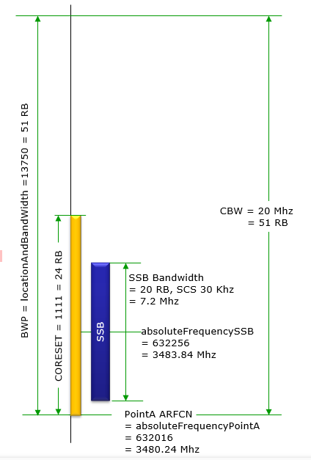
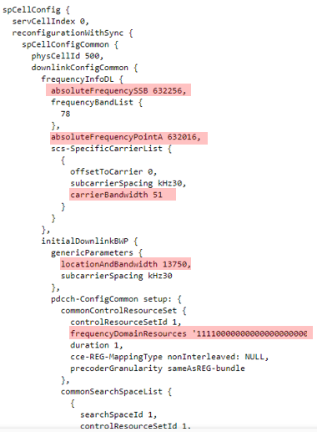
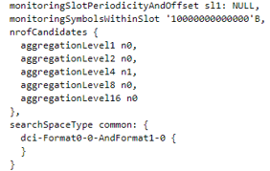
An example configuration - BWP
NOTE : CBW = 20 is just based on the Bandwidth specification.
The physical bandwidth accupied by 51RB is 18.36 Mhz.

Slide 19
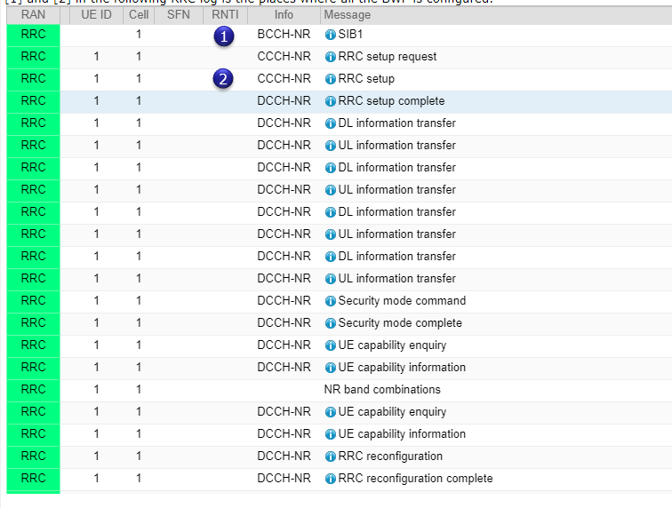
BWP Switching Operation Examples

Slide 20
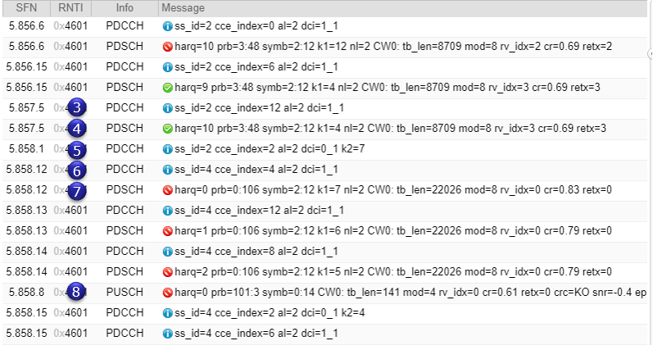
Following is the sequence of physical channels showing the PDCCH/PDSCH before and after BWP switching.

Slide 21
[1] SIB1
message c1: systemInformationBlockType1: {
....
servingCellConfigCommon {
downlinkConfigCommon {
frequencyInfoDL {
frequencyBandList {
{
freqBandIndicatorNR 78
}
},
offsetToPointA 30,
scs-SpecificCarrierList {
{
offsetToCarrier 0,
subcarrierSpacing kHz30,
carrierBandwidth 106
}
}
},
initialDownlinkBWP { // DL BWP 0
genericParameters {
locationAndBandwidth 12928,
subcarrierSpacing kHz30
},
....
},
uplinkConfigCommon {
frequencyInfoUL {
scs-SpecificCarrierList {
{
offsetToCarrier 0,
subcarrierSpacing kHz30,
carrierBandwidth 106
}
}
},
initialUplinkBWP { // UL BWP 0
genericParameters {
locationAndBandwidth 12928,
subcarrierSpacing kHz30
},
....
}
[2] RrcSetup
{
message c1: rrcSetup: {
rrc-TransactionIdentifier 0,
criticalExtensions rrcSetup: {
spCellConfig {
spCellConfigDedicated {
initialDownlinkBWP {
downlinkBWP-ToAddModList {
{
bwp-Id 1,
bwp-Common { // DL BWP 1
genericParameters {
locationAndBandwidth 28875,
subcarrierSpacing kHz30
},
bwp-Dedicated {
pdcch-Config setup: {
},
pdsch-Config setup: {
},
firstActiveDownlinkBWP-Id 0,
uplinkConfig {
initialUplinkBWP {
pucch-Config setup: {
},
},
uplinkBWP-ToAddModList {
{
bwp-Id 1,
bwp-Common {
genericParameters { // UL BWP 1
locationAndBandwidth 28875,
subcarrierSpacing kHz30
},
pusch-ConfigCommon setup: {
},
pucch-ConfigCommon setup: {
}
},
bwp-Dedicated {
pucch-Config setup: {
},
resourceToAddModList {
},
pusch-Config setup: {
},
firstActiveUplinkBWP-Id 0,
},
}
}
}
}
}
}

Slide 22
[3] PDCCH
Message: ss_id=2 cce_index=12 al=2 dci=1_1
Data:
bwp=0
rb_alloc=0x5f
time_domain_rsc=0
mcs1=21
ndi1=0
rv_idx1=3
harq_process=10
dai=0
tpc_command=1
pucch_rsc=0
harq_feedback_timing=4
antenna_ports=2
srs_request=0
dmrs_seq_init=0
[4] PDSCH
Message: harq=10 prb=3:48 symb=2:12 k1=4 nl=2 CW0: tb_len=8709 mod=8 rv_idx=3 cr=0.69 retx=3
[5] PDCCH
Message: ss_id=2 cce_index=2 al=2 dci=0_1 k2=7
Data:
bwp=1
rb_alloc=0x139
time_domain_rsc=0
mcs=9
ndi=1
rv_idx=0
harq_process=0
dai=3
tpc_command=1
antenna_ports=0
srs_request=0
dmrs_seq_init=0
ul_sch_indicator=1

Slide 23
[6] PDCCH
Message: ss_id=4 cce_index=4 al=2 dci=1_1
Data:
bwp=1
rb_alloc=0xd3
time_domain_rsc=0
mcs1=23
ndi1=0
rv_idx1=0
harq_process=0
dai=0
tpc_command=1
pucch_rsc=0
harq_feedback_timing=1
antenna_ports=2
srs_request=0
dmrs_seq_init=0
[7] PDSCH
Message: harq=0 prb=0:106 symb=2:12 k1=7 nl=2 CW0: tb_len=22026 mod=8 rv_idx=0 cr=0.83 retx=0
[8] PUSCH
Message: harq=0 prb=101:3 symb=0:14 CW0: tb_len=141 mod=4 rv_idx=0 cr=0.61 retx=0 crc=KO snr=-0.4 epre=-124.0 ta=8.8

Slide 24
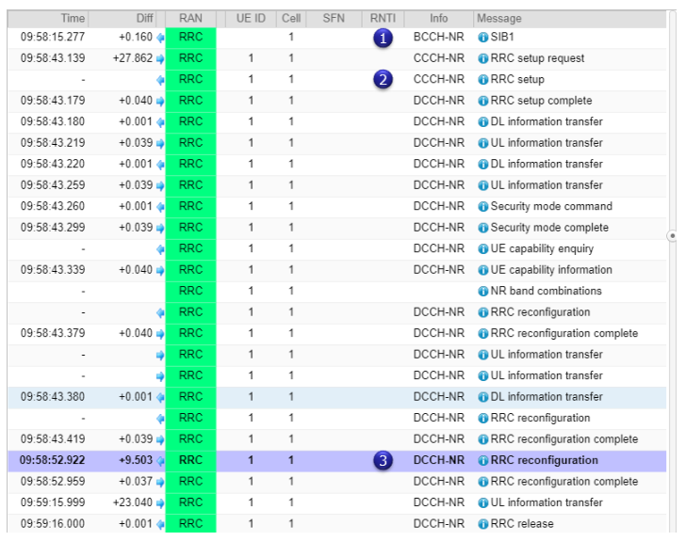
BWP Switching by RRC

Slide 25
[1] SIB1
{
message c1: systemInformationBlockType1: {
servingCellConfigCommon {
downlinkConfigCommon {
frequencyInfoDL {
frequencyBandList {
{
freqBandIndicatorNR 78
}
},
offsetToPointA 30,
scs-SpecificCarrierList {
{
offsetToCarrier 0,
subcarrierSpacing kHz30,
carrierBandwidth 106
}
}
},
initialDownlinkBWP {
genericParameters {
locationAndBandwidth 12928,
subcarrierSpacing kHz30
},
uplinkConfigCommon {
frequencyInfoUL {
scs-SpecificCarrierList {
{
offsetToCarrier 0,
subcarrierSpacing kHz30,
carrierBandwidth 106
}
}
},
initialUplinkBWP {
genericParameters {
locationAndBandwidth 12928,
subcarrierSpacing kHz30
},
}
[2] RrcSetup
{
message c1: rrcSetup: {
rrc-TransactionIdentifier 0,
criticalExtensions rrcSetup: {
radioBearerConfig {
...
spCellConfig {
spCellConfigDedicated {
initialDownlinkBWP {
....
downlinkBWP-ToAddModList {
{
bwp-Id 1,
bwp-Common {
genericParameters {
locationAndBandwidth 28875,
subcarrierSpacing kHz30
},
....
firstActiveDownlinkBWP-Id 0,
....,
uplinkBWP-ToAddModList {
{
bwp-Id 1,
bwp-Common {
genericParameters {
locationAndBandwidth 28875,
subcarrierSpacing kHz30
},
....
firstActiveUplinkBWP-Id 0,
}

Slide 26
[3] RrcReconfiguration
{
message c1: rrcReconfiguration: {
rrc-TransactionIdentifier 0,
criticalExtensions rrcReconfiguration: {
nonCriticalExtension {
masterCellGroup {
cellGroupId 0,
spCellConfig {
spCellConfigDedicated {
firstActiveDownlinkBWP-Id 1,
uplinkConfig {
firstActiveUplinkBWP-Id 1
},
tag-Id 0
}
}
}
}
}
}
}
[4] PDCCH @ SFN = 334.3
Message: ss_id=2 cce_index=8 al=2 dci=1_1
Data:
bwp=0
rb_alloc=0x2f
time_domain_rsc=0
mcs1=9
ndi1=1
rv_idx1=0
harq_process=0
dai=0
tpc_command=1
pucch_rsc=0
harq_feedback_timing=2
antenna_ports=2
srs_request=0
dmrs_seq_init=0
[5] PDCCH @ SFN = 360.5
Message: ss_id=4 cce_index=8 al=2 dci=1_1
Data:
bwp=1
rb_alloc=0x0
time_domain_rsc=0
mcs1=9
ndi1=1
rv_idx1=0
harq_process=0
dai=0
tpc_command=1
pucch_rsc=0
harq_feedback_timing=4
antenna_ports=2
srs_request=0
dmrs_seq_init=0

Slide 27
Measurement (LTE-NR Measurement)
In real operation, it is expected for LTE to perform the measurement of the NR cell before it tries adding it. When it comes to measurement, first we need to think of what kind of measurement event to be used. And since this is interfrequency/ interRAT from the point of LTE we need to think of measurement gap.
In terms of measurement event, we are using the existing event B1 and B2 and not new event is defined for NR measurement, but in terms of measurement gap, we got a lot of new gap patterns for NR measurement.
Example for measurement
message c1: rrcConnectionReconfiguration: {
rrc-TransactionIdentifier 0,
criticalExtensions c1: rrcConnectionReconfiguration-r8: {
measConfig {
measObjectToAddModList {
{
measObjectId 1,
measObject measObjectEUTRA: {
carrierFreq 300,
allowedMeasBandwidth mbw100,
presenceAntennaPort1 TRUE,
neighCellConfig '01'B
}
},

Slide 28
{
measObjectId 2,
measObject measObjectNR-r15: {
carrierFreq-r15 632256,
rs-ConfigSSB-r15 {
measTimingConfig-r15 {
periodicityAndOffset-r15 sf20-r15: 0,
ssb-Duration-r15 sf1
},
subcarrierSpacingSSB-r15 kHz30
},
quantityConfigSet-r15 1,
bandNR-r15 setup: 78
}
}
},
reportConfigToAddModList {
{
reportConfigId 1,
reportConfig reportConfigInterRAT: {
triggerType event: {
eventId eventB1-NR-r15: {
b1-ThresholdNR-r15 nr-RSRP-r15: 56,
reportOnLeave-r15 FALSE
},
hysteresis 0,
timeToTrigger ms100
},
maxReportCells 8,
reportInterval ms120,
reportAmount r1,
reportQuantityCellNR-r15 {
ss-rsrp TRUE,
ss-rsrq TRUE,
ss-sinr TRUE
}
}
}
},

Slide 29
measIdToAddModList {
{
measId 1,
measObjectId 2,
reportConfigId 1
}
},
quantityConfig {
quantityConfigEUTRA {
filterCoefficientRSRP fc3
},
quantityConfigNRList-r15 {
{
measQuantityCellNR-r15 {
filterCoeff-RSRP-r15 fc3
}
}
}
},
measGapConfig setup: {
gapOffset gp0: 16
}
},
......
}
message c1: measurementReport: {
criticalExtensions c1: measurementReport-r8: {
measResults {
measId 1,
measResultPCell {
rsrpResult 69,
rsrqResult 30
},
measResultNeighCells measResultNeighCellListNR-r15: {
{
pci-r15 500,
measResultCell-r15 {
rsrpResult-r15 79,
rsrqResult-r15 65,
rs-sinr-Result-r15 89
}
}
}
}
}
}
}

Slide 30
UE Capability
The purpose (Function) of UE Capability Information in NR is same as LTE UE Capability Information. In LTE UE capability information carries the information in roughly two large category : RF/Physical layer information and Feature Group(FGI). NR also reports similar information (i.e, RF/PHY information and Feature sets) but much more diverse information than LTE.
For the details of the meaning of each IEs listed here, refer to 38.306. But to understand the exact meaning of the descriptions in 38.306, you would need to understand the whole NR specification... simply put, it would be life time job to understand the full details of what you see in the UE capability information. So.. don't be hurry.. take time trying to one at a time.

Slide 31
UE Capability Enquiry - NR
Followings overall structure of UE Capability Enquiries for NR.
UECapabilityEnquiry ::= SEQUENCE {
rrc-TransactionIdentifier RRC-TransactionIdentifier,
criticalExtensions CHOICE {
ueCapabilityEnquiry UECapabilityEnquiry-IEs,
criticalExtensionsFuture SEQUENCE {}
}
}
UECapabilityEnquiry-IEs ::= SEQUENCE {
ue-CapabilityRAT-RequestList UE-CapabilityRAT-RequestList,
lateNonCriticalExtension OCTET STRING OPTIONAL,
ue-CapabilityEnquiryExt OCTET STRING (CONTAINING UECapabilityEnquiry-v1560-IEs) OPTIONAL
}
UECapabilityEnquiry-v1560-IEs ::= SEQUENCE {
capabilityRequestFilterCommon UE-CapabilityRequestFilterCommon OPTIONAL, -- Need N
nonCriticalExtension UECapabilityEnquiry-v1610-IEs OPTIONAL
}
UECapabilityEnquiry-v1610-IEs ::= SEQUENCE {
rrc-SegAllowed-r16 ENUMERATED {enabled} OPTIONAL, -- Need N
nonCriticalExtension SEQUENCE {} OPTIONAL
}
UE-CapabilityRAT-RequestList ::= SEQUENCE (SIZE (1..maxRAT-CapabilityContainers))
OF UE-CapabilityRAT-Request
UE-CapabilityRAT-Request ::= SEQUENCE {
rat-Type RAT-Type,
capabilityRequestFilter OCTET STRING OPTIONAL, -- Need N
...
}
UE-CapabilityRequestFilterNR ::= SEQUENCE {
frequencyBandListFilter FreqBandList OPTIONAL, -- Need N
nonCriticalExtension UE-CapabilityRequestFilterNR-v1540 OPTIONAL
}
UE-CapabilityRequestFilterNR-v1540 ::= SEQUENCE {
srs-SwitchingTimeRequest ENUMERATED {true} OPTIONAL, -- Need N
nonCriticalExtension SEQUENCE {} OPTIONAL
}

Slide 32
Example nr single band
message c1: ueCapabilityEnquiry: {
rrc-TransactionIdentifier 0,
criticalExtensions ueCapabilityEnquiry: {
ue-CapabilityRAT-RequestList {
{
rat-Type nr,
capabilityRequestFilter {
frequencyBandListFilter {
bandInformationNR: {
bandNR 78
}
}
}
}
},
ue-CapabilityEnquiryExt {
nonCriticalExtension {
rrc-SegAllowed-r16 enabled
}
}
}
}
Example nr multi band
{
message c1: ueCapabilityEnquiry: {
rrc-TransactionIdentifier 0,
criticalExtensions ueCapabilityEnquiry: {
ue-CapabilityRAT-RequestList {
{
rat-Type nr,
capabilityRequestFilter {
frequencyBandListFilter {
bandInformationNR: {
bandNR 1
},
bandInformationNR: {
bandNR 2
},
bandInformationNR: {
bandNR 3
},
bandInformationNR: {
bandNR 4
},
bandInformationNR: {
bandNR 5
},
bandInformationNR: {
bandNR 6
},
bandInformationNR: {
bandNR 7
},
bandInformationNR: {
bandNR 8
},
ue-CapabilityEnquiryExt {
nonCriticalExtension {
rrc-SegAllowed-r16 enabled
}
}

Slide 33
An example of NSA band combination
rf-ParametersMRDC {
supportedBandCombinationList {
{
bandList {
eutra: {
bandEUTRA 8,
ca-BandwidthClassDL-EUTRA a,
ca-BandwidthClassUL-EUTRA a
},
nr: {
bandNR 78,
ca-BandwidthClassDL-NR a,
ca-BandwidthClassUL-NR a
}
},
featureSetCombination 0,
mrdc-Parameters {
simultaneousRxTxInterBandENDC supported,
asyncIntraBandENDC supported
},
supportedBandwidthCombinationSet '0'B
},

Slide 34
An example of supported bandwidth in SA.
channelBWs-DL-v1530 fr1: {
scs-15kHz '0000000000'B,
scs-30kHz '0000001111'B, => support 40,50,60,80 and 100 (max BW)
scs-60kHz '0000000000'B
},
channelBWs-UL-v1530 fr1: {
scs-15kHz '0000000000'B,
scs-30kHz '0000001111'B, => support 40,50,60,80 and 100 (max BW)
scs-60kHz '0000000000'B
}
38.306 specifies the meaning of this IE as follows :
channelBWs-DL/channelBWs-UL :
Indicates for each subcarrier spacing whether the UE supports channel bandwidths lower than the maximum channel bandwidth as defined in TS 38.101-1 and TS 38.101-2 . If this parameter is not included, it mean that the UE supports the channel bandwidths among [5, 10, 15, 20, 25, 30, 40, 50, 60, 80, 100] in FR1 and [50, 100, 200] in FR2.
For FR1, the bits starting from the leading / leftmost bit indicate 5, 10, 15, 20, 25, 30, 40, 50, 60 and 80MHz. For FR2, the bits starting from the leading / leftmost bit indicate 50, 100 and 200MHz.
NOTE : it is assumed that the maximum bandwidth (in most case 100Mhz in FR1 SCS30, 50 Mhz in FR1 SCS 15, 400 Mhz FR2) is supported by default.

Slide 35
Cell Search
Cell search is the procedure for a UE to acquire time and frequency synchronization with a cell and to detect the physical layer Cell ID of the cell.
A UE receives the following synchronization signals (SS) in order to perform cell search: the primary synchronization signal (PSS) and secondary synchronization signal (SSS)
For a half frame with SS/PBCH blocks (SSB), the first symbol indexes for candidate SS/PBCH blocks are determined according to the SCS of SS/PBCH blocks as follows, where index 0 corresponds to the first symbol of the first slot in a half-frame.
Cell search is the procedure by which a UE acquires time and frequency synchronization with a cell and detects the Cell ID of that cell. NR cell search is based on the primary and secondary synchronization signals, and PBCH DMRS, located on the synchronization raster.
In any cellular communication system (2G, 3G, 4G, 5G), there are specific procedure called Cell Search. Even though the detailed mechanism varies a little bit depending on each specific Cellular Technology, the basic concept and purpose is same. They are same in 5G/NR as well.

Slide 36
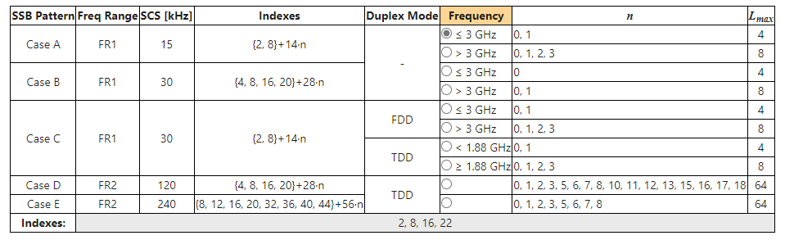
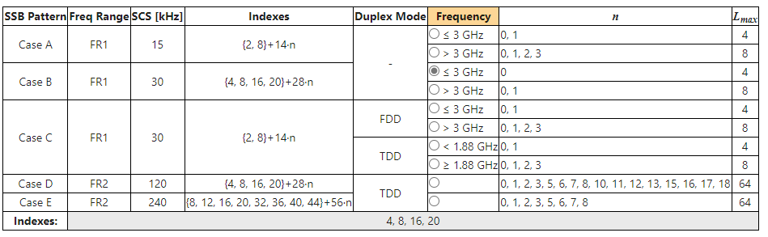
SSB patterns applicable to different frequencies and duplexing modes
When Frequency <=3 GHz
The indexes are 2,8,16,22 in Case A
When Frequency is <=3GHz
The indexes are 4.8.16.20 in Case B

Slide 37
Note:
For Case A, Case B, and Case C, they each has two sub-patterns: one sub-pattern with 4 SSBs per set, applicable to low frequencies, another sub-pattern with 8 SSBs per set, applicable to high frequencies.
Case A and Case C have same SSB pattern, despite the different SCS and the frequency thresholds for sub-patterns.
For an FR1 TDD band, it may have different SSBs per set depends on the SCS configuration. E.g., band n39 and n41 lie between 1.88GHz ~ 3GHz. They both support patterns Case A and Case C. When using Case A, the frequency is below the threshold, the first sub-pattern is effective with L_{max} = 4. When using Case C, the frequency is above the threshold, the second sub-pattern is effective with L_{max} = 8.

Slide 38
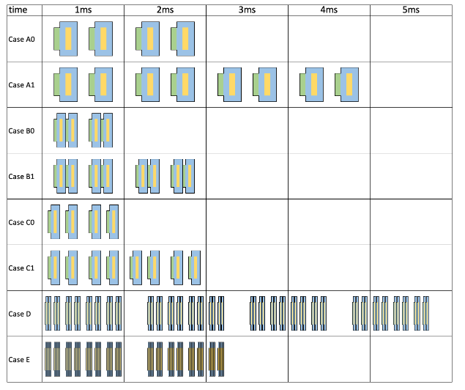
SSB Patterns

Slide 39
How to decide the SSB pattern to use
if SCS for SS/PBCH blocks is unknown, the applicable cases for a cell depend on a respective frequency band, as provided in TS 38.101 Table 5.4.3.3-1. For bands with two possible SCSs, UE needs to try both SCS hypothesis to detect the SSB.
if the SCS of SS/PBCH blocks is provided by ssbSubcarrierSpacing:
if SCS equals 15 / 120 / 240 kHz, Case A / D / E shall be used, respectively.
if SCS equals 30 kHz,
for frequency bands with only 15 kHz SS/PBCH block SCS as specified in TS 38.101 Table 5.4.3.3-1: Case B shall be used. Otherwise,
the case is jointly decided by the SCS and the band, which can be either Case B or Case C.
How to obtain SSB index and cell timing after SSB is detected
An SSB can be identified using a combination of System Frame Number (SFN), the Half Radio Frame flag, and the SSB index.
SFN is indicated by 10 bits (0 ~ 1023). The 6 Most Significant Bits (MSB) of the SFN occupy the first 6 bits of Master Information Block (MIB); the 4 Least Significant Bits (LSB) occupy the first 4 bits of PBCH payload.
The Half Radio Frame flag is communicated in PBCH, it occupies the 5th bit of PBCH payload. If the SSB pattern has only 4 SSBs per set, the Half Radio Frame flag can also be deducted from the PBCH DMRS scrambling sequence: the 3rd bit of the sequence index.
The SSBs in a half frame are indexed in an ascending order in time from 0 to L_{max}-1:
When there are 4 SSBs in the set (Case A0, B0, C0), the SSB index corresponds to the first two bits of DMRS sequence index.
When there are 8 SSBs in the set (Case A1, B1, C1), the SSB index is same as the DMRS sequence index.
When there are 64 SSBs in the set (Case D, E), the 3 MSB bits are taken from the 8th/7th/6th bits of PBCH payload, and the 3 LSB bits correspond to the DMRS sequence index.

Slide 40
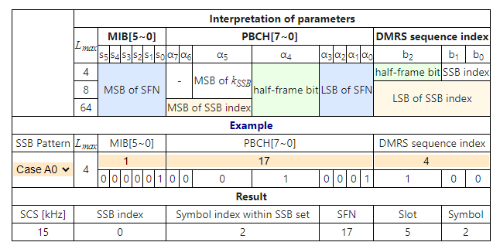
obtain cell time from SSB
Case A0
MIB=1
PBCH=17
DMRS sequence index=4
Based on the above values the get the “Result” values

Slide 41
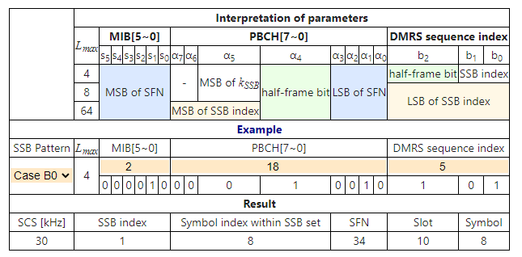
Case B0
MIB = 2
PBCH = 18
DMRS sequence index = 5

Slide 42
How to decide the periodicity of the SSB burst set
Serving cell: ssb-periodicityServingCell, The SSB periodicity (5/10/20/40/80/160) in ms for the rate matching purpose. If the field is absent, UE assumes a periodicity of 5 ms.
Initial cell selection: assumes a periodicity of 20ms.
Neighbor cell: SSB-MTC, which is used to configure measurement timing configurations, i.e., timing occasions at which the UE measures SSBs. The periodicity can be 5/10/20/40/80/160 ms.
How to determine the frequency location of Type0-PDCCH CSS CORESET
First UE decode MIB, and obtain the value of k_{SSB} from MIB.
If k_{SSB} ≤ 23 for FR1 or k_{SSB} ≤ 11 for FR2, UE follows TS 38.213 Clause 13 to determine the CORESET;
If k_{SSB} > 23 for FR1 or k_{SSB} > 11 for FR2, the CORESET is not present.
The CORESET for Type0-PDCCH CSS set may be provided by PDCCH-ConfigCommon.

Slide 43
END
Thank You

